Slide 1
CLOUD COMPUTING
1) Cloud computing is a general term used to describe a new class of network based
computing that takes place over the internet
One step higher from Utility Computing
A collection / group of integrated and networked hardware, software and internet
Infrastructure (called a platform)
Using the internet for communication and transport provides hardware, software and
networking services to clients
2) These platforms hide the complexity and details of the underlying infrastructure from users
and applications by providing very simple graphical interface or API (Applications
Programming Interface)
3) In addition the platform provides on-demand services that are always available at any time
and any place.
4) The hardware and software services are available to general public, enterprises, corporations
and business markets.

Slide 2
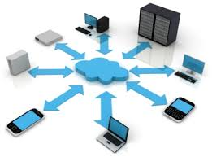
CLOUD COMPUTING CHARACTERISTICS
Common Characteristics
Massive scale | Resilient computing
Homogeneity | Geographic
Virtualization | Service Orientation
Low cost software | Advanced security
Essential Characteristics
On demand self – service | Rapid elasticity
Broad network access | Measured service
Resource Pooling

Slide 3
CLOUD SERVICE MODELS
Software as a service
(SAAS)
Software as a service provider application
Platform as a service
(PAAS)
Platform as a service deploy customer
Infrastructure as a
service (IAAS)
Infrastructure as a service processing, storage and computing sources

